Slide 1
Princess Sumaya University for Technology
Computing Sciences Research Center
Comparative study of word embeddings models and
their usage in Arabic language applications
Dima Suleiman
Prof. Arafat Awajan
29-11-2018

Slide 2
About the Presenter
Dima Suleiman
Education:
PhD. Computer Science, Deep Learning, NLP (2015-)
MSc. Computer Science (2002-2004)
BSc. Computer Science(1998-2002)
Contact:
Dima.suleiman@ju.edu.jo
Dimah_1999@yahoo.com

Slide 3
Agenda
Introduction
Overview of word embeddings models
Word2vec Model
Global Vectors for Word Representation(Glove) Model
Word embeddings uses in Arabic NLP
Evaluation and pre-trained word embeddings
Discussions and Conclusion

Slide 4
Introduction
Word embeddings is used to represent the words by low dimensional vectors representation
There are several models for generating word embeddings.
In order to be useful, these models must be trained using very large corpus to determine the semantic relationship between words since the semantic similarity is crucial for several applications.
The similarity between words can be measured using cosine similarity, Euclidean distance and other techniques.

Slide 5
Overview of word embeddings models
Word2vec consists of two approaches:
Continuous Bag-of-Words Model (CBOW)
Continuous Skip-gram Model (Skip-gram)
Global Vectors for Word Representation(Glove) Model

Slide 6
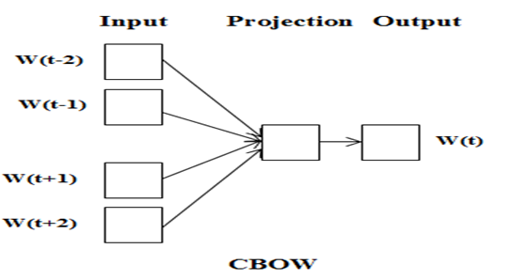
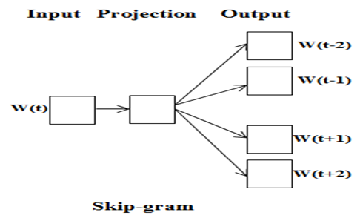
Background (Word2vec)
Continuous Bag-of-Words model (CBOW), which predicts the current word depending on neighboring words
Continuous Skip-gram model (Skip-gram) where the current word is the input and the model predicts the surrounding words.
Figure 2 - CBOW and Skip-gram models architecture[Mikolov, T., Chen, K., Corrado, G., & Dean, J. (2013).

Slide 7
Which model is better?

Slide 8
Which approach is better?
Case | Model Name
Training small dataset | Skip-gram
Infrequent words | Skip-gram
Frequent words | CBOW

Slide 9
Background (Glove)
Glove captures the statistics of the global corpus directly from the model, instead of depending on local context windows like word2vec model.
Glove uses the statistics efficiently by training the model on the global count of word-to-word co-occurrence

Slide 10
Conclusion
As a conclusion, the use of word embeddings is highly dependent on the application
Based on small dimensional semantic space, word2vec produces best representation of the words vectors compared with Glove.

Slide 11
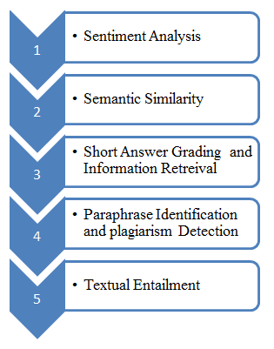
Word embeddings uses in Arabic NLP
Figure 3 – Word embedding applications

Slide 12
Year | Application | Word Embeddings | Dataset | Pre-processing
2015 | Word Representations | Skip-gram, CBOW and Glove | Arabic Wikipedia Arabic Gigaword Corpus, etc | Normalization, such as removing diacritics, tags and replacing all numerical digits using the word “NUM”
2016 | Sentiment Analysis | CBOW and Skip-gram | Abu El-Khair corpus (training the word2vec) Arabic tweet dataset which consisted of 1398 negative tweets and 628 positive tweets | Removing of special characters, any none Arabic words or digits, such as 1234 or Hindi digit used in Arabic, such as ١٢٣٤.
2017 | Sentiment Analysis | word2vec , glove and doc2vec | LABR(sentiment) freely available 63257 book reviews | Light stemming
2016 | Sentiment Analysis | CBOW | ASTD, ArTwitter and QCRI | Extracting the tokens from sentence in order to join them again in certain order
2017 | Semantic Similarity | CBOW | 5.8 billion words training including Arabic Wikipedia, Arabase, OSAC, and others | Stop-word, punctuation marks, diacritics and non-letters removal. Normalizing letters and Normalizing numerical digits to the token ”Num”
2018 | Semantic Similarity | Weighting Aligned Words, Bag-of-Words Alignment | four datasets from SemEval-2017 STS task consisted of 2412 pairs of sentences | Tokenization, Removing punctuation marks, diacritics, and non-alphanumeric characters, normalizing characters, the stop words were not removed
2015 | Short Answer Grading | word2vec and Glove | Texas computer science, Extended Texas computer science, Cairo University and SemEval 2013 | Lemmatization, stemming and stop words removal
2018 | information retrieval | CBOW, Skip-gram and Glove | TREC 2001/2002 data sets which consist of 75 topics | Heavy stemming, Farasa stemming, light stemming and normalization
2017 | plagiarism detection | CBOW | OSAC | Without preprocessing
2016 | Paraphrase Identification | Skip-gram | OSAC | Identify sentences using “,” “;” “.” “:” “!” “?”. Identify words using spaces
2017 | Arabic Textual Entailment | Skip-gram | ArbTE | SPLIT, Removing URLs and punctuation were removed and numbers and dates were normalized to Num and Date tokenization, Lemmatization and stemming they used MADAMIRA stop words removal

Slide 13
Evaluation of word embeddings
There are two evaluation ways of space vectors representation including:
Intrinsic:
Extrinsic.
The semantic and syntactic similarity of words was evaluated using semantic and syntactic benchmark dataset which was used to evaluate the models quality
The word embeddings were evaluated through using it in NLP applications

Slide 14
Pre-trained word embeddings
According to the importance of using word embeddings in several NLP applications pre-trained Arabic word embeddings models was proposed and called AraVec.
AraVec is an open source project of pre-trained Arabic distributed words embeddings that enables Arabic researchers to use free and powerful model in their researches.

Slide 15
Pre-trained word embeddings
AraVec was published in 2017
AraVec trained using CBOW and Skip-gram approaches of word2vec.
Tweets, article of Arabic Wikipedia and World Wide Web pages with total number of tokens more than 3,300,000,000 were used for training.
The datasets collected were normalize and non-Arabic content filtering was applied.

Slide 16
Discussions and Conclusion
Word embeddings were used in various Arabic NLP applications.
Training of the word embeddings model was conducted in large Arabic dataset such as OSAC, SemEval-2017, LABR, ArbTE, Abu El-Khair corpus, where most of them are freely available.
Some of researchers collected their own dataset from Twitter, Wikipedia and World Wide Web pages.

Slide 17
Discussions and Conclusion
Several data preprocessing were applied on the dataset, where the most common preprocessing are:
Normalization.
Lemmatization.
Stemming.
Removing of stop words, diacritics, tags, URLs and punctuation marks.
Normalizing the numbers and dates by replacing them with Num and Date tokens.

Slide 18
Thank You
Princess Sumaya University for Technology
Computing Sciences Research Center

